Slide 1
Shape of simple inorganic molecules
Name of the instructor: U.Nithya M.Sc.,M.Phil.,

Slide 2
Structure of Becl₂:
Atomic number: 4
E.C. : 1S²2S²
Hybridisation. : SP
Shape of molecule : Linear

Slide 3
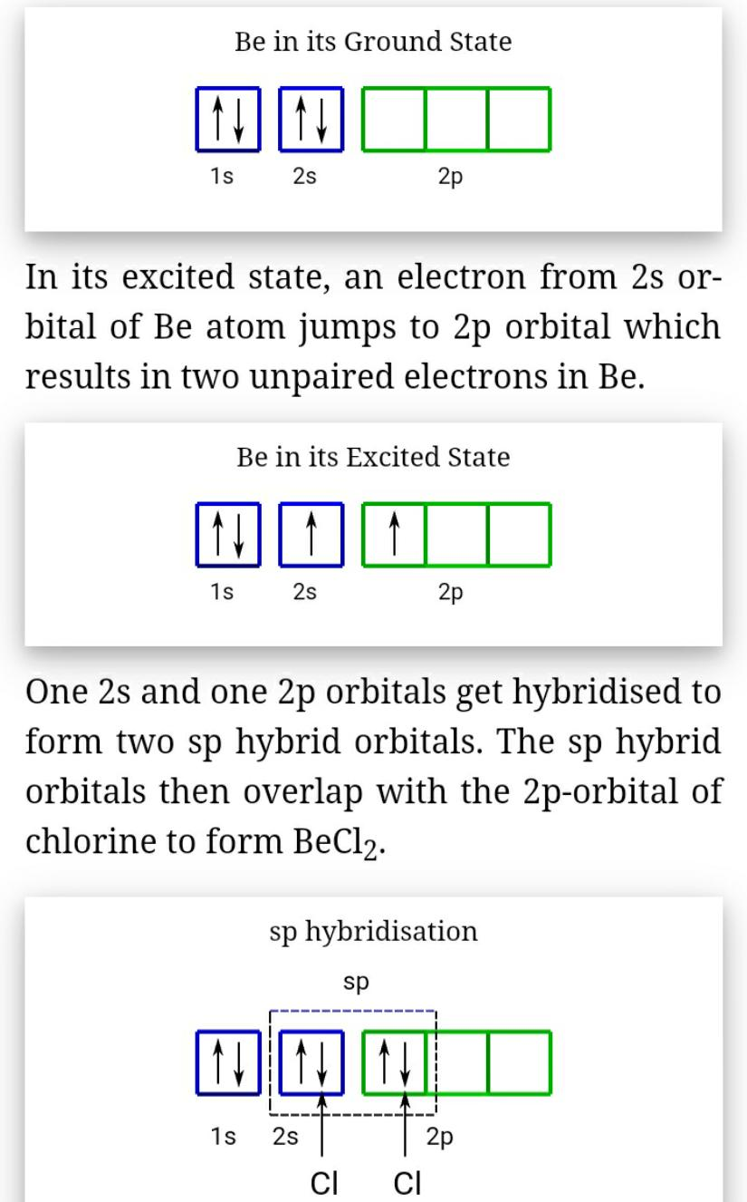

Slide 4
Structure of BF₃ :
Atomic number: 5
E.C. : 1S²2S² 2P¹
Hybridisation. : SP²
Shape of molecule :Trigonal planar

Slide 5
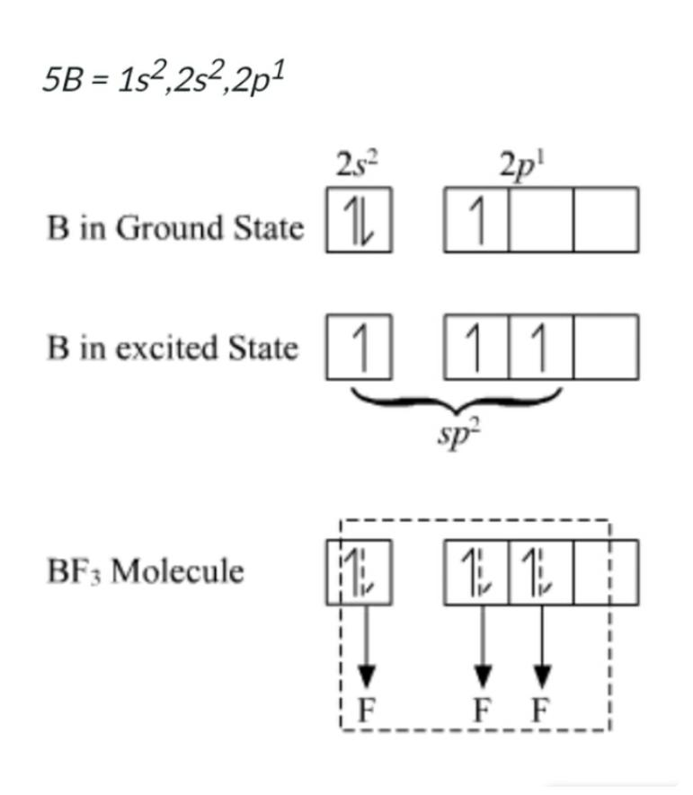

Slide 6
Structure of Sicl₄:
Atomic number: 14
E.C. : [Ne] 3S²3P²
Hybridisation. : SP³
Shape of molecule : Tetrahetral

Slide 7
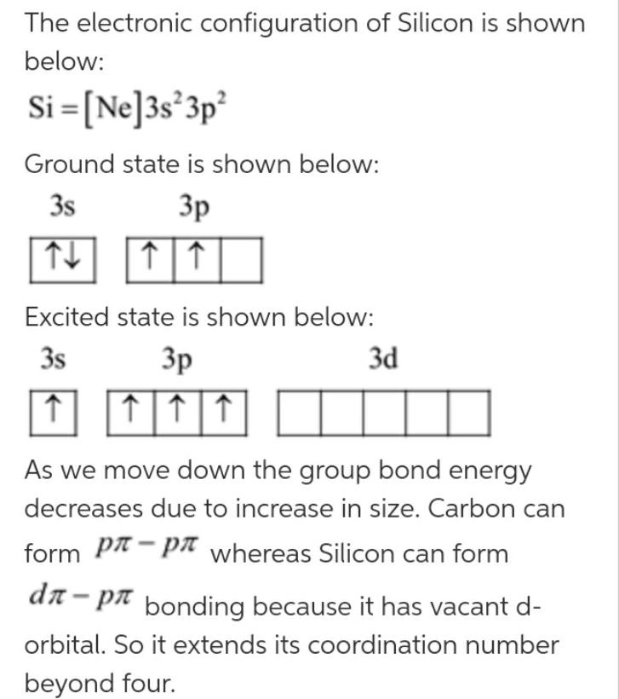

Slide 8
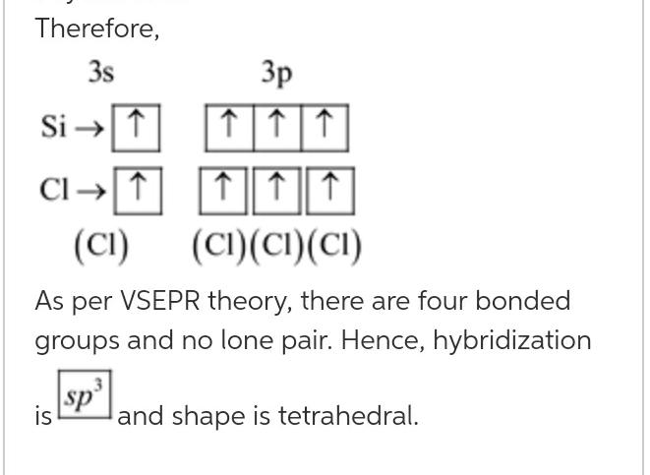

Slide 9
Structure of Pcl₅:
Atomic number: 15
E.C. : [Ne] 3S²3P³
Hybridisation. : SP³d
Shape of molecule : Trigonal bipyramidal

Slide 10
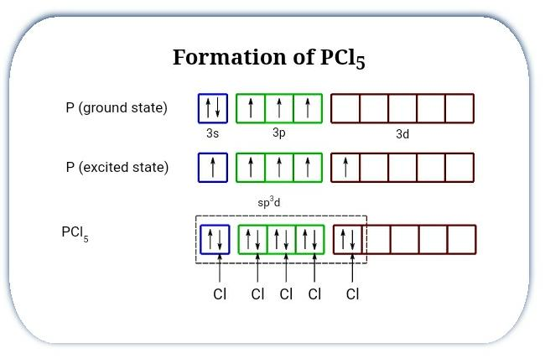

Slide 11
Structure of SF₆ :
Atomic number: 16
E.C. : [Ne] 3S²3P⁶
Hybridisation. : SP³d²
Shape of molecule : Octahedral

Slide 12
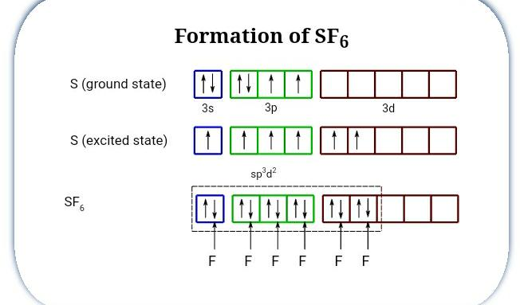

Slide 13
Structure of IF₇ :
Atomic number: 53
E.C. : [Kr] 4d¹⁰5S² 5P⁵
Hybridisation. : SP³d³
Shape of molecule : pentagonal bipyramidal

Slide 14
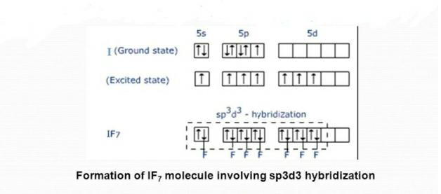

Slide 15
Structure of IF₅:
Atomic number: 53
E.C. : [Kr]4d¹⁰5s²5p⁵
Hybridisation. : SP³d²
Shape of molecule : Square pyramidal

Slide 16
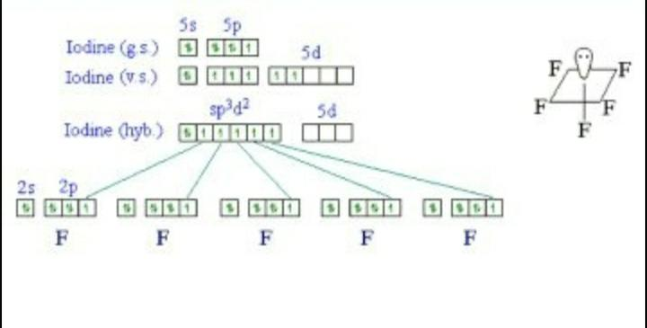

Slide 17
Structure of XeF₆:
Atomic number: 54
E.C. : [Kr] 4d¹⁰5S²5P⁶
Hybridisation. : SP³d³
Shape of molecule : pentagonal bipyramidal

Slide 18
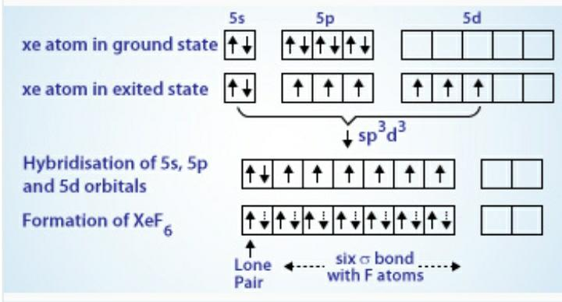

Slide 19
THANK YOU

